Slide 1
CS 7643: Deep Learning
Topics:
Computational Graphs
Notation + example
Computing Gradients
Forward mode vs Reverse mode AD
Dhruv Batra
Georgia Tech

Slide 2
Administrativia
HW1 Released
Due: 09/22
PS1 Solutions
Coming soon

Slide 3
Project
Goal
Chance to try Deep Learning
Combine with other classes / research / credits / anything
You have our blanket permission
Extra credit for shooting for a publication
Encouraged to apply to your research (computer vision, NLP, robotics,…)
Must be done this semester.
Main categories
Application/Survey
Compare a bunch of existing algorithms on a new application domain of your interest
Formulation/Development
Formulate a new model or algorithm for a new or old problem
Theory
Theoretically analyze an existing algorithm

Slide 4
Administrativia
Project Teams Google Doc
https://docs.google.com/spreadsheets/d/1AaXY0JE4lAbHvoDaWlc9zsmfKMyuGS39JAn9dpeXhhQ/edit#gid=0
Project Title
1-3 sentence project summary TL;DR
Team member names + GT IDs

Slide 5
Recap of last time

Slide 6
How do we compute gradients?
Manual Differentiation
Symbolic Differentiation
Numerical Differentiation
Automatic Differentiation
Forward mode AD
Reverse mode AD
aka “backprop”

Slide 7
Computational Graph
Any DAG of differentiable modules is allowed!
Slide Credit: Marc'Aurelio Ranzato

Slide 8
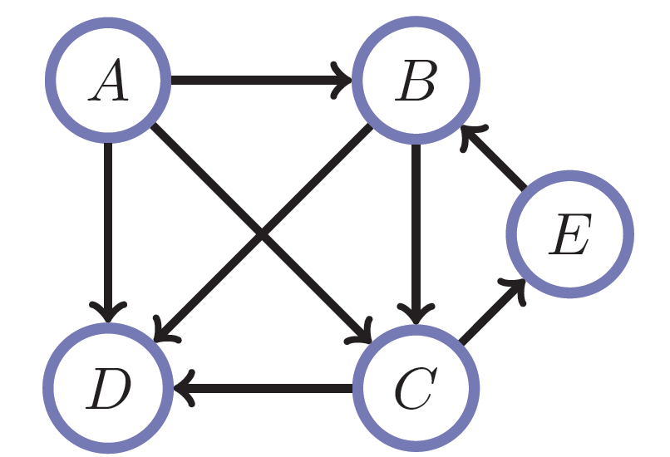
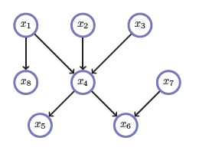
Directed Acyclic Graphs (DAGs)
Exactly what the name suggests
Directed edges
No (directed) cycles
Underlying undirected cycles okay

Slide 9
Directed Acyclic Graphs (DAGs)
Concept
Topological Ordering

Slide 10
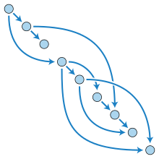
Directed Acyclic Graphs (DAGs)

Slide 11
Computational Graphs
Notation #1

Slide 12
Computational Graphs
Notation #2

Slide 13
Example
+
sin( )
*
x₁
x₂

Slide 14
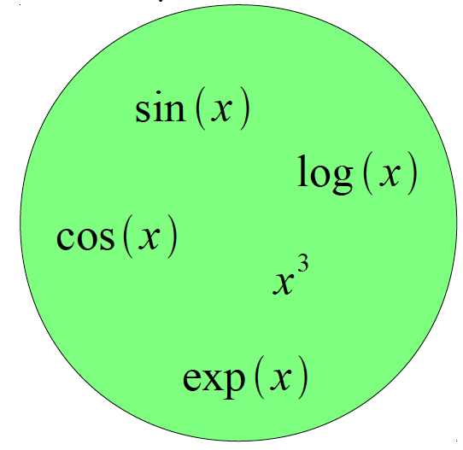
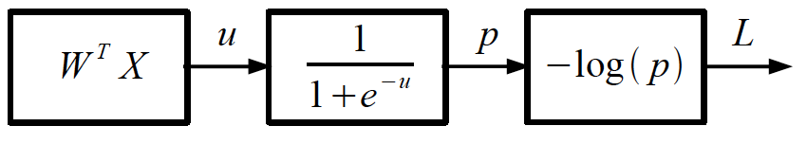
Logistic Regression as a Cascade
Given a library of simple functions
Compose into a
complicate function
Slide Credit: Marc'Aurelio Ranzato, Yann LeCun

Slide 15
Forward mode vs Reverse Mode
Key Computations

Slide 16
Forward mode AD
g
Notes:
What we’re doing in backprop is we have all these nodes in our computational graph, each node only aware of immediate surroundings
at each node have ...

Slide 17
Reverse mode AD
g
Notes:
What we’re doing in backprop is we have all these nodes in our computational graph, each node only aware of immediate surroundings
at each node have ...

Slide 18
Example: Forward mode AD
+
sin( )
*
x₁
x₂

Slide 19
Example: Forward mode AD
+
sin( )
*
x₁
x₂

Slide 20
Example: Forward mode AD
+
sin( )
*
x₁
x₂

Slide 21
Example: Reverse mode AD
+
sin( )
*
x₁
x₂

Slide 22
Example: Reverse mode AD
+
sin( )
*
x₁
x₂

Slide 23
Forward Pass vs Forward mode AD vs Reverse Mode AD
+
sin( )
*
x₁
x₂
+
+
sin( )
*
sin( )
*
x₁
x₂
x₁
x₂

Slide 24
Forward mode vs Reverse Mode
What are the differences?
Which one is more memory efficient (less storage)?
Forward or backward?

Slide 25
Forward mode vs Reverse Mode
What are the differences?
Which one is more memory efficient (less storage)?
Forward or backward?
Which one is faster to compute?
Forward or backward?

Slide 26
Plan for Today
(Finish) Computing Gradients
Forward mode vs Reverse mode AD
Patterns in backprop
Backprop in FC+ReLU NNs
Convolutional Neural Networks

Slide 27
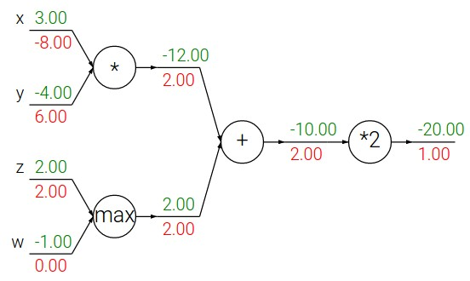
Patterns in backward flow
Slide Credit: Fei-Fei Li, Justin Johnson, Serena Yeung, CS 231n

Slide 28
Patterns in backward flow
Slide Credit: Fei-Fei Li, Justin Johnson, Serena Yeung, CS 231n

Slide 29
Patterns in backward flow
add gate: gradient distributor
Slide Credit: Fei-Fei Li, Justin Johnson, Serena Yeung, CS 231n

Slide 30
Patterns in backward flow
add gate: gradient distributor
Q: What is a max gate?
Slide Credit: Fei-Fei Li, Justin Johnson, Serena Yeung, CS 231n

Slide 31
Patterns in backward flow
add gate: gradient distributor
max gate: gradient router
Slide Credit: Fei-Fei Li, Justin Johnson, Serena Yeung, CS 231n

Slide 32
Patterns in backward flow
add gate: gradient distributor
max gate: gradient router
Q: What is a mul gate?
Slide Credit: Fei-Fei Li, Justin Johnson, Serena Yeung, CS 231n

Slide 33
Patterns in backward flow
add gate: gradient distributor
max gate: gradient router
mul gate: gradient switcher
Slide Credit: Fei-Fei Li, Justin Johnson, Serena Yeung, CS 231n
Notes:
Gradient switcher and scaler
Mul: scale upstream gradient by value of other branch

Slide 34
Gradients add at branches
+
Slide Credit: Fei-Fei Li, Justin Johnson, Serena Yeung, CS 231n
Notes:
Gradients add at branches, from multivariate chain rule
Since wiggling this node affects both connected nodes in the forward pass, then at backprop the upstream gradient coming into this node is the sum of the gradients flowing back from both nodes

Slide 35
Duality in Fprop and Bprop
FPROP
BPROP
SUM
+
COPY
+

Slide 36
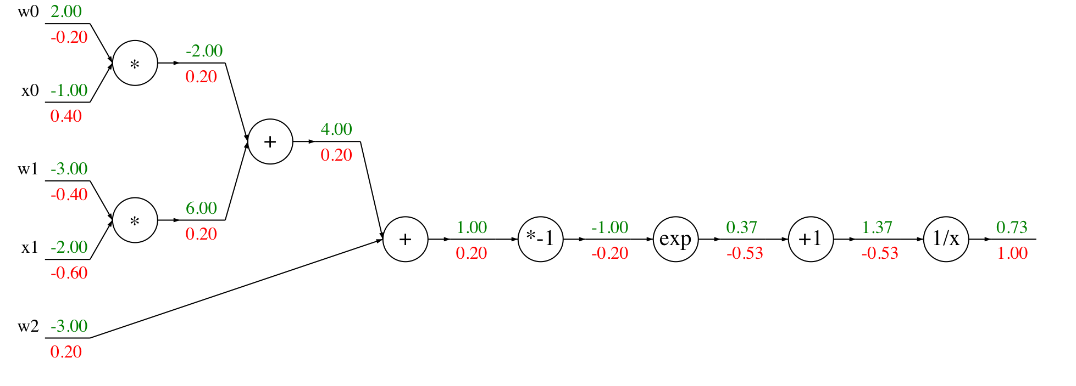
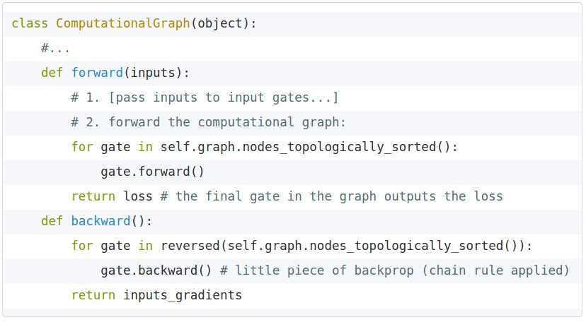
Modularized implementation: forward / backward API
Graph (or Net) object (rough psuedo code)
Slide Credit: Fei-Fei Li, Justin Johnson, Serena Yeung, CS 231n
Notes:
During forward pass cache intermediary computation

Slide 37
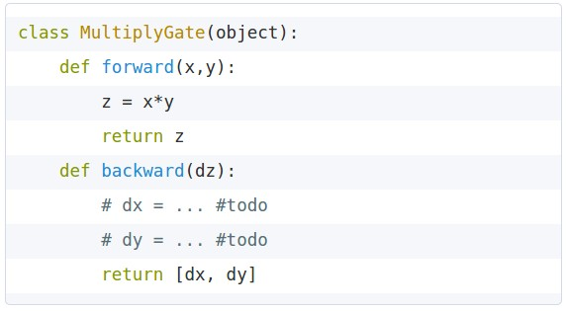
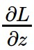
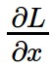
Modularized implementation: forward / backward API
x
z
*
y
(x,y,z are scalars)
Slide Credit: Fei-Fei Li, Justin Johnson, Serena Yeung, CS 231n
Notes:
The implementation exactly mirrors the algorithm in that it’s completely local

Slide 38
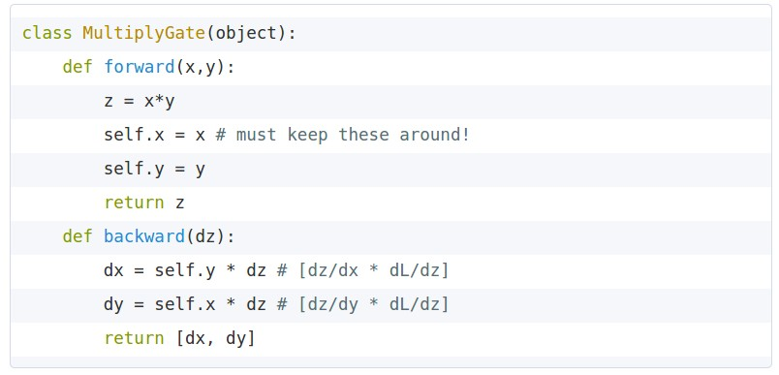
Modularized implementation: forward / backward API
x
z
*
y
(x,y,z are scalars)
Slide Credit: Fei-Fei Li, Justin Johnson, Serena Yeung, CS 231n

Slide 39
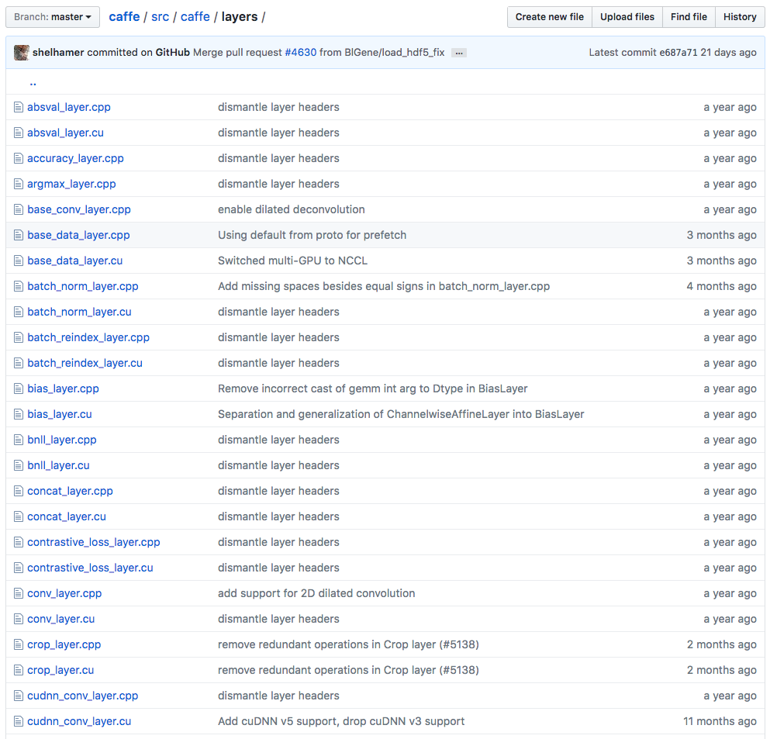
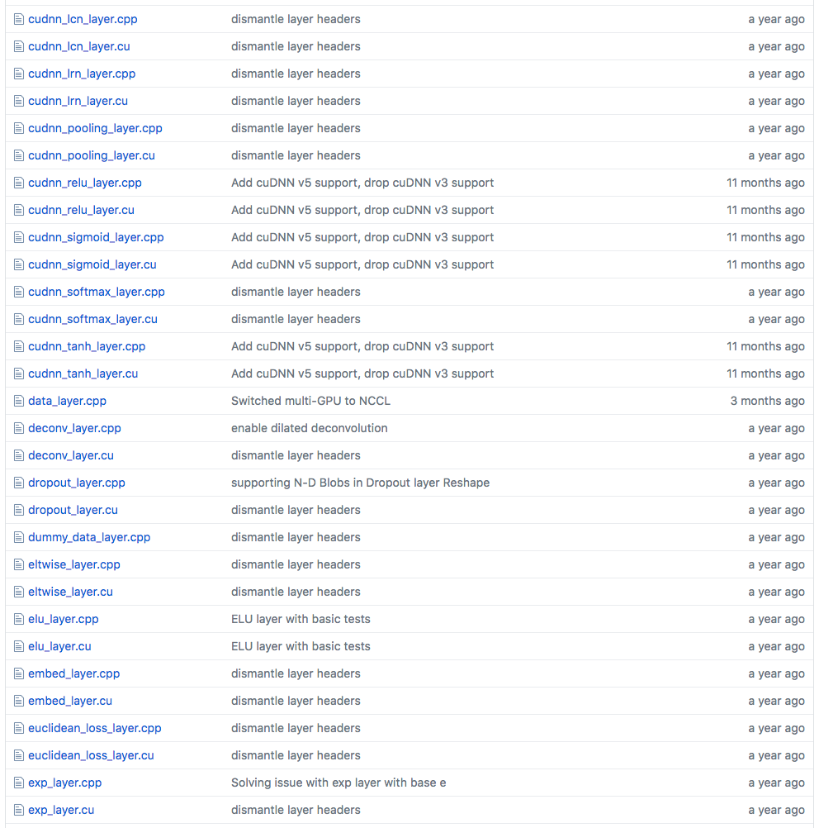
Example: Caffe layers
Caffe is licensed under BSD 2-Clause
Slide Credit: Fei-Fei Li, Justin Johnson, Serena Yeung, CS 231n
Notes:
Higher level node
Beautiful thing is only need to implement forward and backward

Slide 40
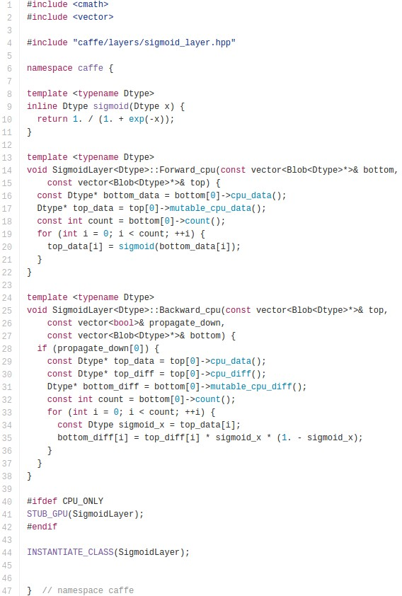
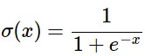
Caffe Sigmoid Layer
* top_diff (chain rule)
Caffe is licensed under BSD 2-Clause
Slide Credit: Fei-Fei Li, Justin Johnson, Serena Yeung, CS 231n

Slide 41
Figure Credit: Andrea Vedaldi

Slide 42
Figure Credit: Andrea Vedaldi

Slide 43
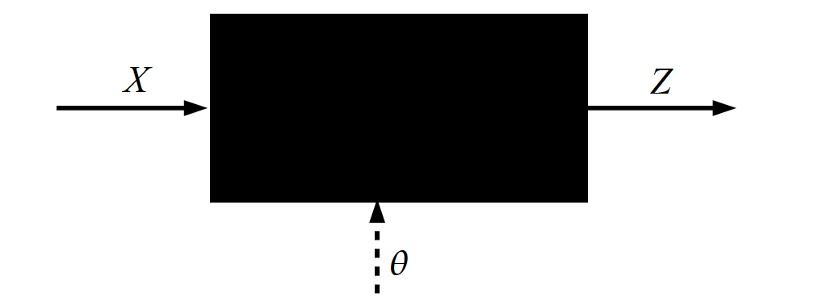
Key Computation in DL: Forward-Prop
Slide Credit: Marc'Aurelio Ranzato, Yann LeCun

Slide 44
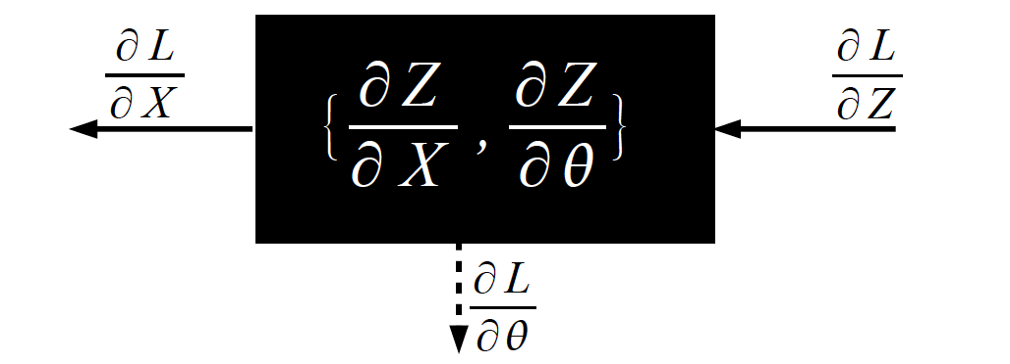
Key Computation in DL: Back-Prop
Slide Credit: Marc'Aurelio Ranzato, Yann LeCun

Slide 45
Jacobian of ReLU
f(x) = max(0,x)
(elementwise)
4096-d
input vector
4096-d
output vector
Slide Credit: Fei-Fei Li, Justin Johnson, Serena Yeung, CS 231n

Slide 46
Jacobian of ReLU
f(x) = max(0,x)
(elementwise)
4096-d
input vector
4096-d
output vector
Q: what is the size of the Jacobian matrix?
Slide Credit: Fei-Fei Li, Justin Johnson, Serena Yeung, CS 231n
Notes:
Partial deriv. Of each dimension of output with respect to each dimension of input

Slide 47
Jacobian of ReLU
f(x) = max(0,x)
(elementwise)
4096-d
input vector
4096-d
output vector
Q: what is the size of the Jacobian matrix?
[4096 x 4096!]
Slide Credit: Fei-Fei Li, Justin Johnson, Serena Yeung, CS 231n

Slide 48
Jacobian of ReLU
f(x) = max(0,x)
(elementwise)
4096-d
input vector
4096-d
output vector
Q: what is the size of the Jacobian matrix?
[4096 x 4096!]
in practice we process an entire minibatch (e.g. 100) of examples at one time:
i.e. Jacobian would technically be a
[409,600 x 409,600] matrix :\
Slide Credit: Fei-Fei Li, Justin Johnson, Serena Yeung, CS 231n

Slide 49
Jacobian of ReLU
f(x) = max(0,x)
(elementwise)
4096-d
input vector
4096-d
output vector
Q: what is the size of the Jacobian matrix?
[4096 x 4096!]
Q2: what does it look like?
Slide Credit: Fei-Fei Li, Justin Johnson, Serena Yeung, CS 231n
Notes:
For each elem in input, for each elem in output

Slide 50
Jacobians of FC-Layer

Slide 51
Jacobians of FC-Layer

Slide 52
Jacobians of FC-Layer

Slide 53
Convolutional Neural Networks
(without the brain stuff)
Slide Credit: Fei-Fei Li, Justin Johnson, Serena Yeung, CS 231n

Slide 54
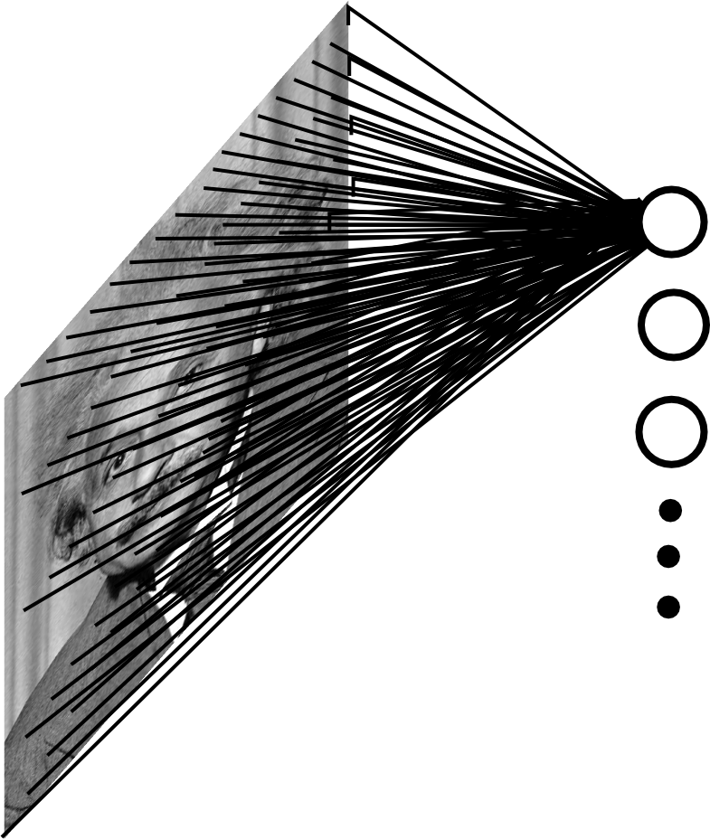
Fully Connected Layer
Example: 200x200 image
40K hidden units
~2B parameters!!!
- Spatial correlation is local
- Waste of resources + we have not enough training samples anyway..
Slide Credit: Marc'Aurelio Ranzato

Slide 55
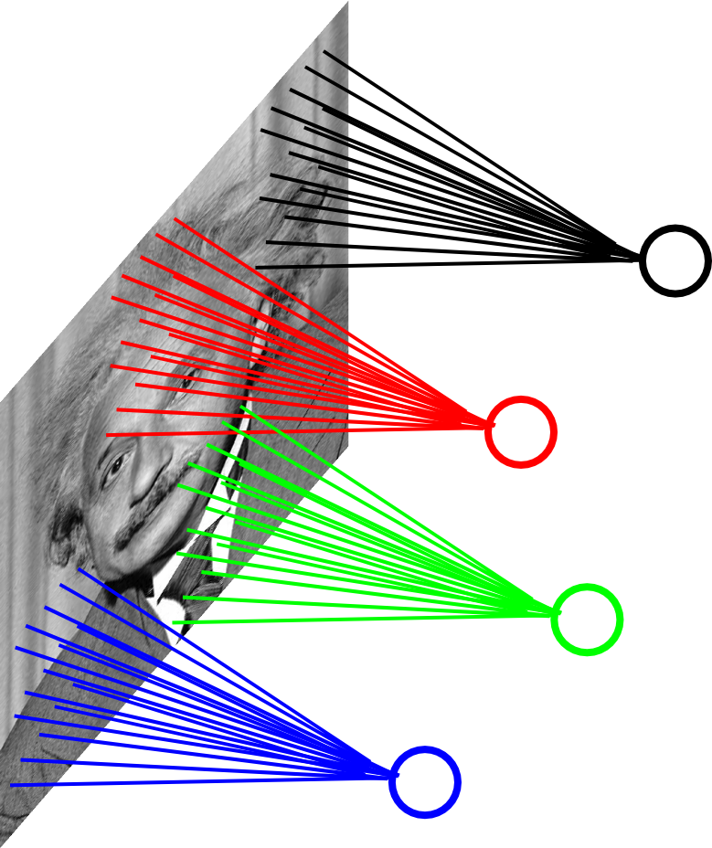
Locally Connected Layer
Example: 200x200 image
40K hidden units
Filter size: 10x10
4M parameters
Note: This parameterization is good when input image is registered (e.g., face recognition).
Slide Credit: Marc'Aurelio Ranzato

Slide 56
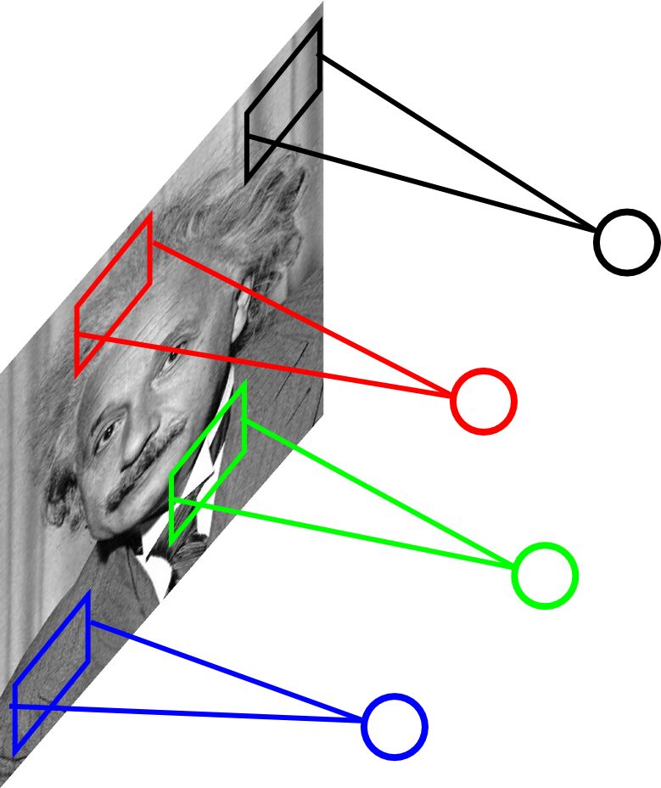
Locally Connected Layer
STATIONARITY? Statistics is similar at different locations
Example: 200x200 image
40K hidden units
Filter size: 10x10
4M parameters
Note: This parameterization is good when input image is registered (e.g., face recognition).
Slide Credit: Marc'Aurelio Ranzato

Slide 57
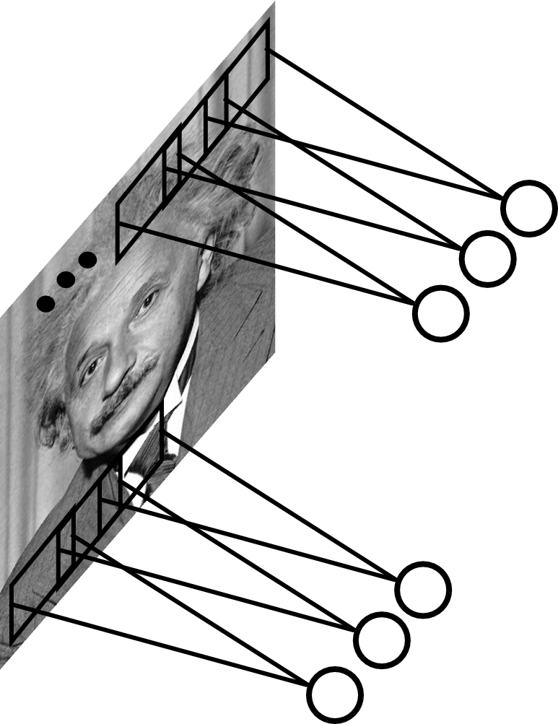
Convolutional Layer
Share the same parameters across different locations (assuming input is stationary):
Convolutions with learned kernels
Slide Credit: Marc'Aurelio Ranzato

Slide 58
Convolutions for mathematicians

Slide 59


"Convolution of box signal with itself2" by Convolution_of_box_signal_with_itself.gif: Brian Ambergderivative work: Tinos (talk) - Convolution_of_box_signal_with_itself.gif. Licensed under CC BY-SA 3.0 via Commons - https://commons.wikimedia.org/wiki/File:Convolution_of_box_signal_with_itself2.gif#/media/File:Convolution_of_box_signal_with_itself2.gif

Slide 60
Convolutions for computer scientists

Slide 61
Convolutions for programmers

Slide 62
Convolution Explained
http://setosa.io/ev/image-kernels/
https://github.com/bruckner/deepViz

Slide 63
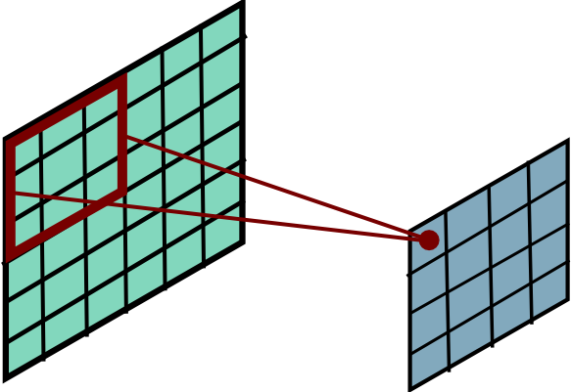
Convolutional Layer
Slide Credit: Marc'Aurelio Ranzato

Slide 64
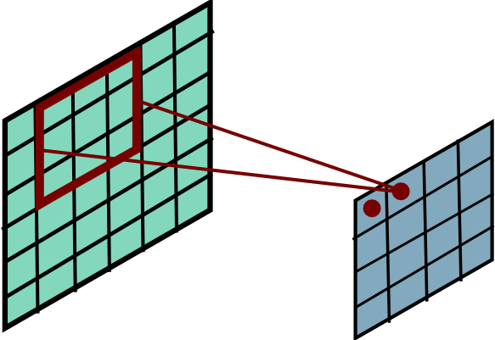
Convolutional Layer
Slide Credit: Marc'Aurelio Ranzato

Slide 65
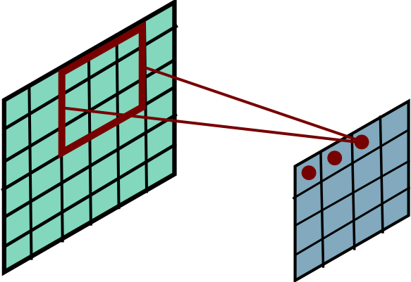
Convolutional Layer
Slide Credit: Marc'Aurelio Ranzato

Slide 66
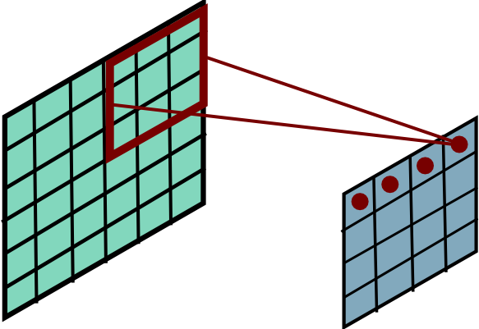
Convolutional Layer
Slide Credit: Marc'Aurelio Ranzato

Slide 67
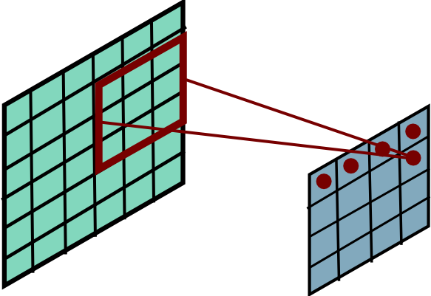
Convolutional Layer
Slide Credit: Marc'Aurelio Ranzato

Slide 68
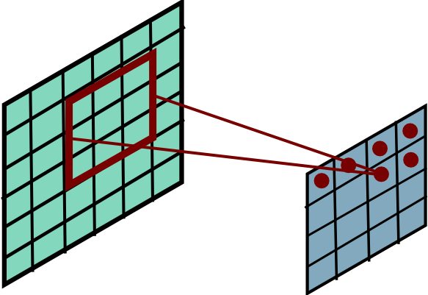
Convolutional Layer
Slide Credit: Marc'Aurelio Ranzato

Slide 69
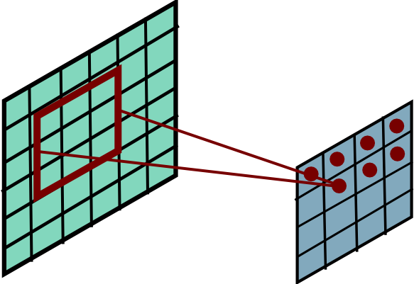
Convolutional Layer
Slide Credit: Marc'Aurelio Ranzato

Slide 70
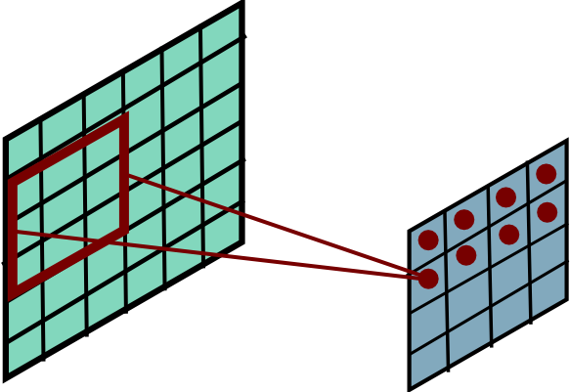
Convolutional Layer
Slide Credit: Marc'Aurelio Ranzato

Slide 71
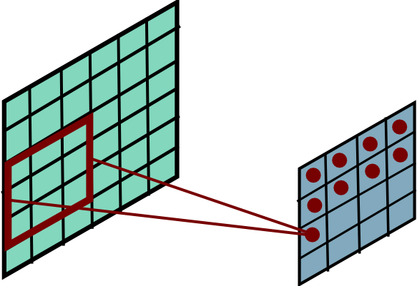
Convolutional Layer
Slide Credit: Marc'Aurelio Ranzato

Slide 72
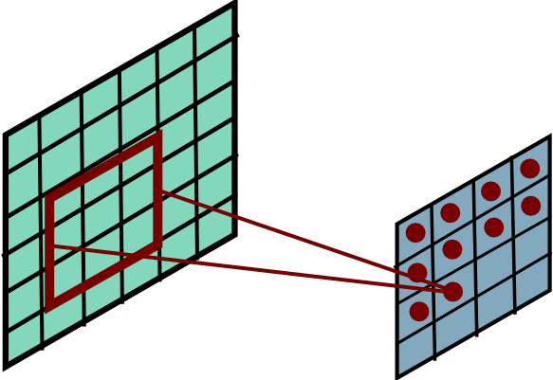
Convolutional Layer
Slide Credit: Marc'Aurelio Ranzato

Slide 73
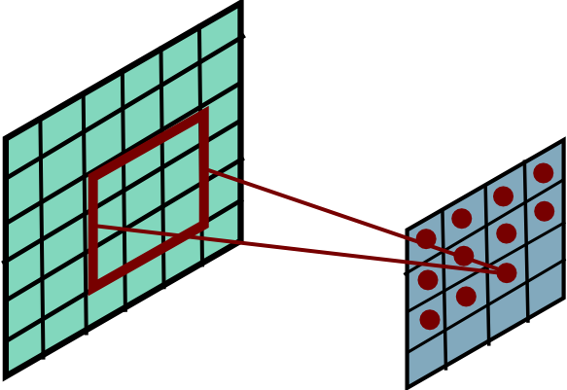
Convolutional Layer
Slide Credit: Marc'Aurelio Ranzato

Slide 74
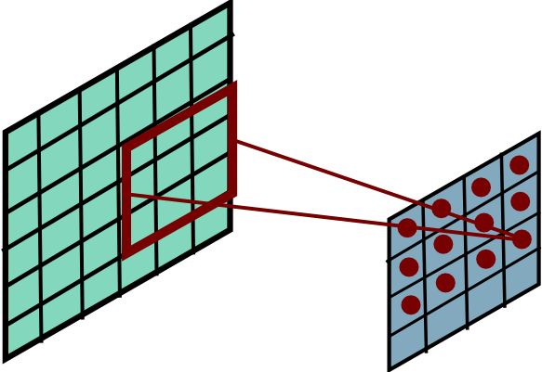
Convolutional Layer
Slide Credit: Marc'Aurelio Ranzato

Slide 75
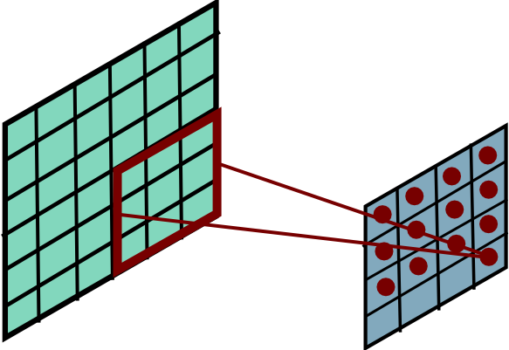
Convolutional Layer
Slide Credit: Marc'Aurelio Ranzato

Slide 76
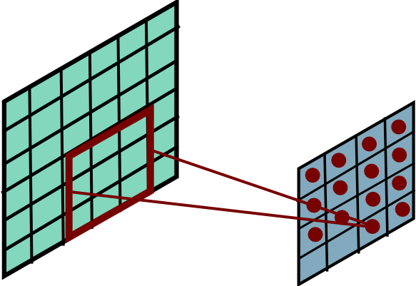
Convolutional Layer
Slide Credit: Marc'Aurelio Ranzato

Slide 77
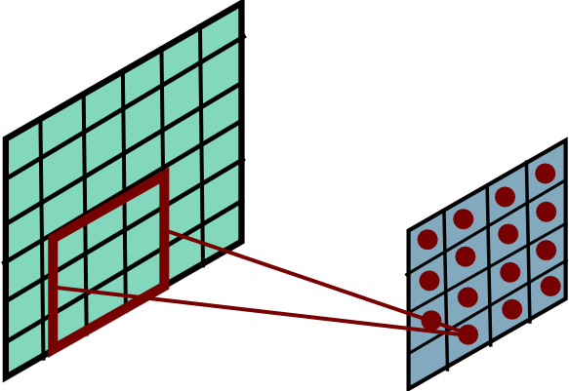
Convolutional Layer
Slide Credit: Marc'Aurelio Ranzato

Slide 78
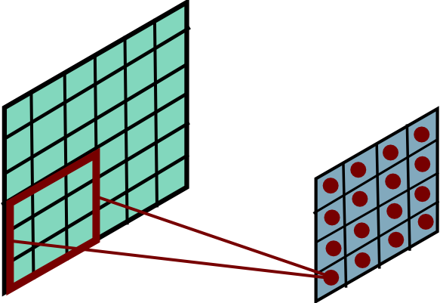
Convolutional Layer
Mathieu et al. “Fast training of CNNs through FFTs” ICLR 2014
Slide Credit: Marc'Aurelio Ranzato

Slide 79
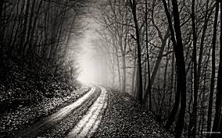
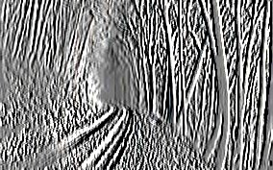
Convolutional Layer
-1 0 1
-1 0 1
-1 0 1
=
*
Slide Credit: Marc'Aurelio Ranzato

Slide 80
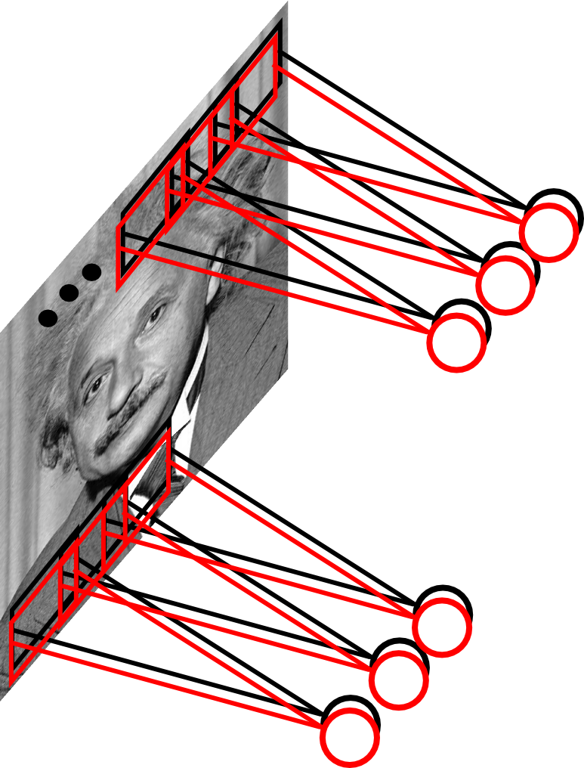
Convolutional Layer
Learn multiple filters.
E.g.: 200x200 image
100 Filters
Filter size: 10x10
10K parameters
Slide Credit: Marc'Aurelio Ranzato

Slide 81
Fully Connected Layer
32x32x3 image -> stretch to 3072 x 1
input
activation
1
1
3072
10 x 3072
weights
10
Slide Credit: Fei-Fei Li, Justin Johnson, Serena Yeung, CS 231n
Notes:
Preserve spatial structure of input

Slide 82
Fully Connected Layer
32x32x3 image -> stretch to 3072 x 1
input
activation
1
1
3072
10 x 3072
weights
10
1 number:
the result of taking a dot product between a row of W and the input (a 3072-dimensional dot product)
Slide Credit: Fei-Fei Li, Justin Johnson, Serena Yeung, CS 231n
Notes:
Preserve spatial structure of input

Slide 83
Convolutional Layer

Slide 84
Convolutional Layer

Slide 85
Convolution Layer
32x32x3 image -> preserve spatial structure
32
height
32
width
3
depth
Slide Credit: Fei-Fei Li, Justin Johnson, Serena Yeung, CS 231n
Notes:
Preserve spatial structure of input

Slide 86
Convolution Layer
32x32x3 image
5x5x3 filter
32
Convolve the filter with the image
i.e. “slide over the image spatially, computing dot products”
32
3
Slide Credit: Fei-Fei Li, Justin Johnson, Serena Yeung, CS 231n

Slide 87
Convolution Layer
Filters always extend the full depth of the input volume
32x32x3 image
5x5x3 filter
32
Convolve the filter with the image
i.e. “slide over the image spatially, computing dot products”
32
3
Slide Credit: Fei-Fei Li, Justin Johnson, Serena Yeung, CS 231n

Slide 88

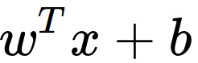
Convolution Layer
32x32x3 image
5x5x3 filter
32
1 number:
the result of taking a dot product between the filter and a small 5x5x3 chunk of the image
(i.e. 5*5*3 = 75-dimensional dot product + bias)
32
3
Slide Credit: Fei-Fei Li, Justin Johnson, Serena Yeung, CS 231n

Slide 89
Convolution Layer
activation map
32x32x3 image
5x5x3 filter
32
28
convolve (slide) over all spatial locations
32
28
3
1
Slide Credit: Fei-Fei Li, Justin Johnson, Serena Yeung, CS 231n

Slide 90
consider a second, green filter
Convolution Layer
32x32x3 image
5x5x3 filter
activation maps
32
28
convolve (slide) over all spatial locations
32
28
3
1
Slide Credit: Fei-Fei Li, Justin Johnson, Serena Yeung, CS 231n

Slide 91
For example, if we had 6 5x5 filters, we’ll get 6 separate activation maps:
activation maps
32
28
Convolution Layer
32
28
3
6
We stack these up to get a “new image” of size 28x28x6!
Slide Credit: Fei-Fei Li, Justin Johnson, Serena Yeung, CS 231n

